Slide 1
Splice II Narrative frames and Christmas Stories
Anne Chapman KCL

Slide 2
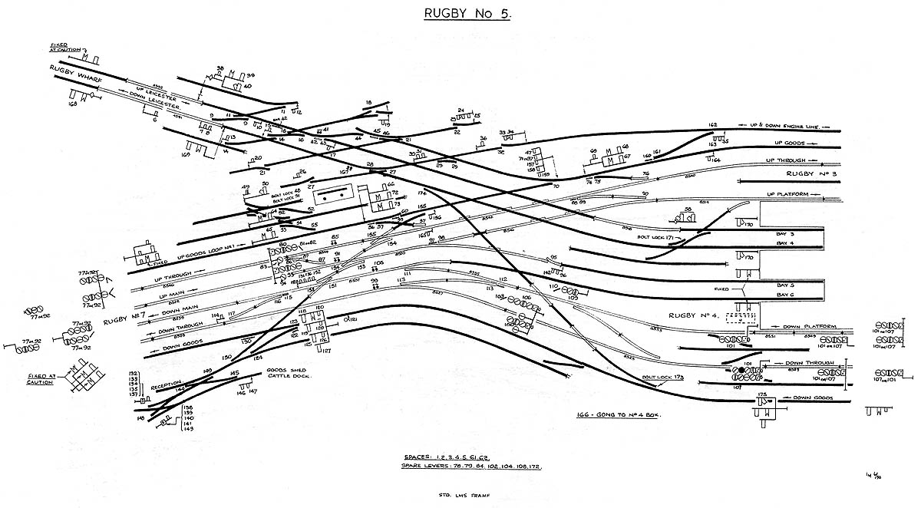

Slide 3
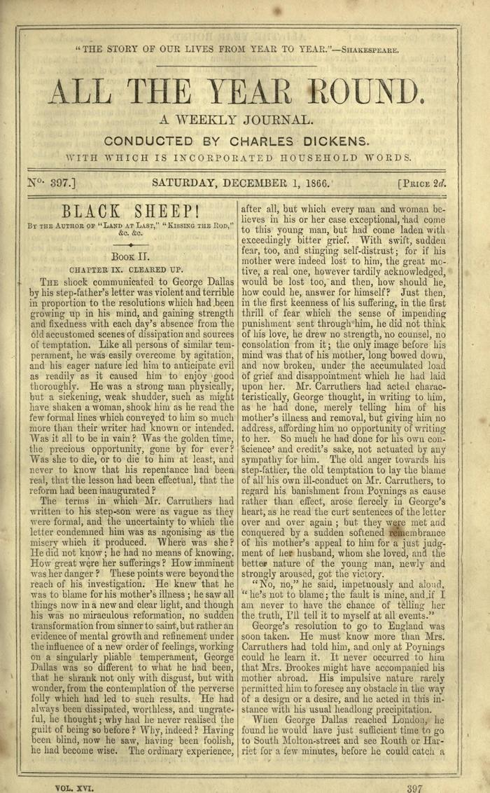

Slide 4
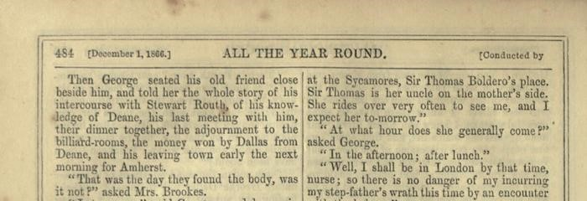
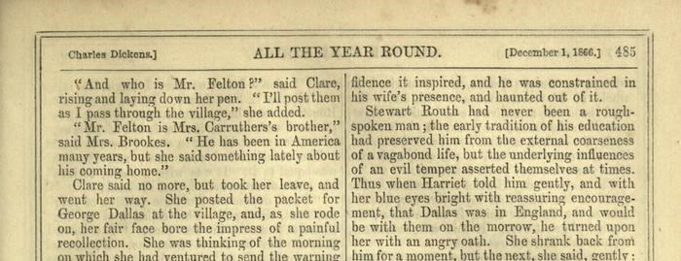

Slide 5
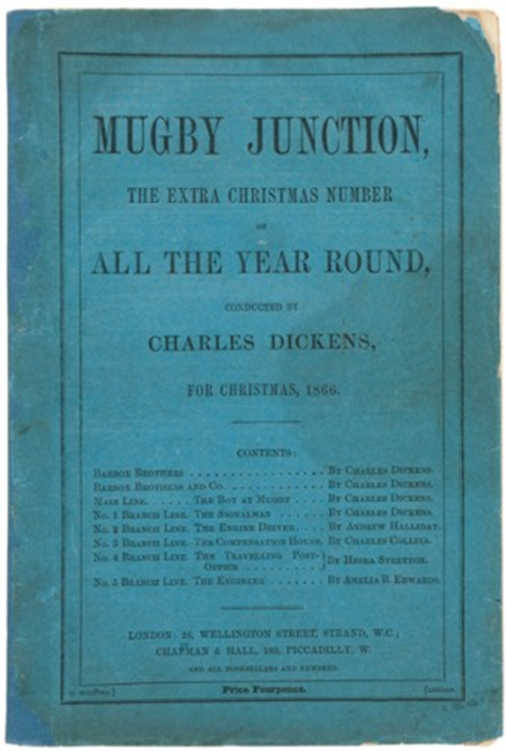

Slide 6
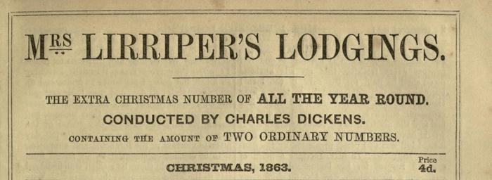
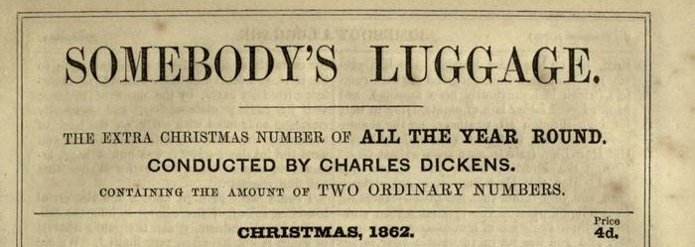
‘We did not discover them in a garret or cellar; they were not left by a mysterious stranger in a carpet-bag with spectacles; they were not related to us by a fellow-lodger who turned out to be our long-lost brother […] nothing of this kind about them.’
Beeton’s Christmas Annual 1866

Slide 7
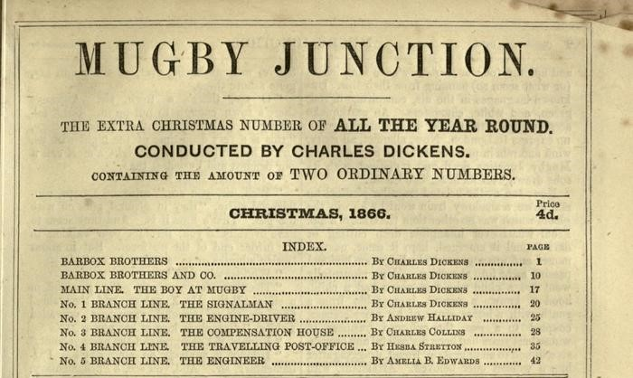

Slide 8
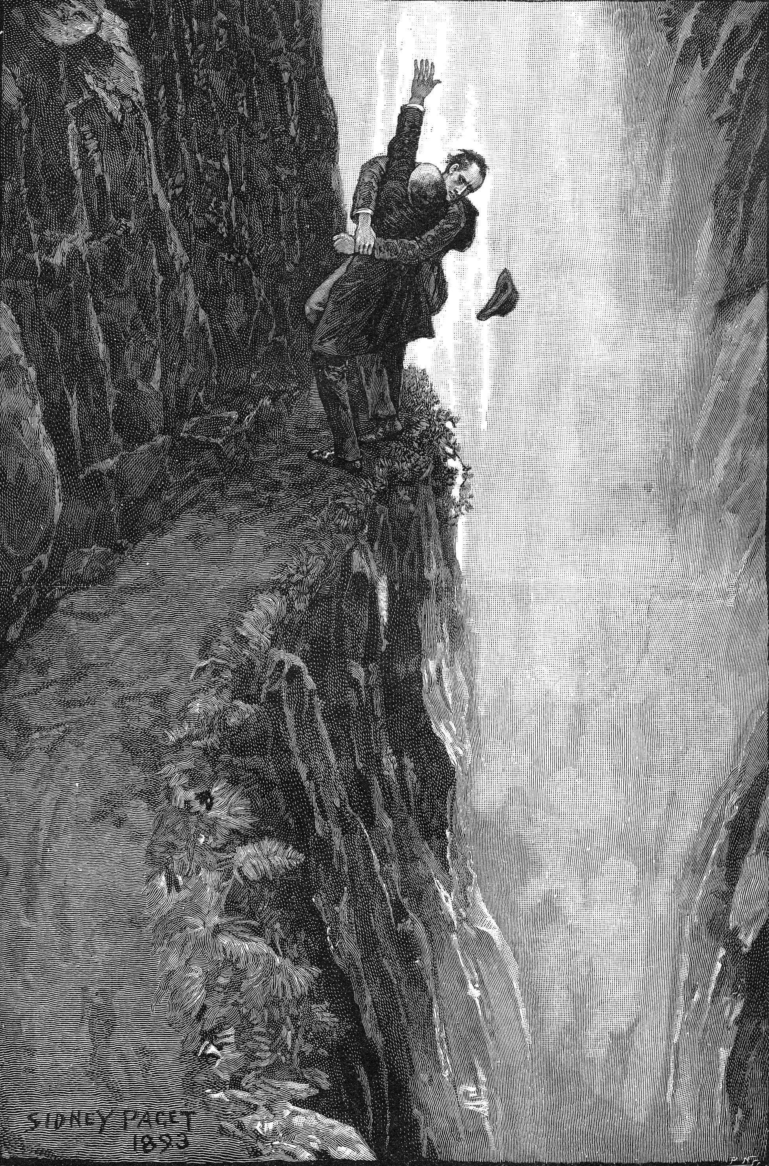
Holmes and Moriarty fighting over the Reichenbach Falls. Illustration by Sidney Paget. Strand Magazine December 1893

