Slide 1

Coding
George Frederic Watts, Ariadne on Naxos, 1875
Look: Watts depicts the moment in a Greek myth where Ariadne grieves for her lover Theseus who has abandoned her on the island of Naxos. Her servant points in the opposite direction to Dionysus coming to claim her as his bride.
This is a switch point between two alternatives.
Telegraphic code often depended on a switching between two alternatives – on or off, dot or dash – in order to send messages clearly.
Image: Guildhall Art Gallery, City of London

Slide 2
Coding
George Frederic Watts, Ariadne on Naxos, 1875
Think: Draw the picture into your sketchbook. Make a comparison between Ariadne and her servant, noting the differences between their appearance (expression, body language, dress, for example) and what that suggests to you about their characters.
We cannot see Theseus or Dionysus in this painting, but other paintings of the same scene do show them. What difference does their absence make to the picture, do you think?
Image: Guildhall Art Gallery, City of London

Slide 3
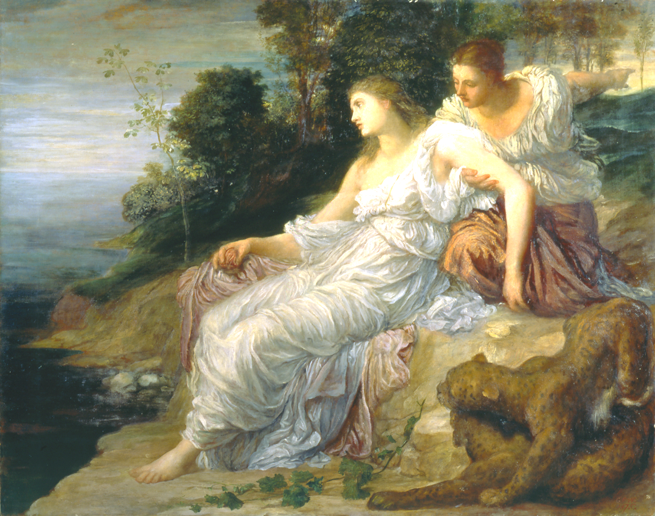
Coding
George Frederic Watts, Ariadne on Naxos, 1875
Try: One of the ways Watts depicts the difference between Ariadne and her servant is in their hair: Ariadne’s is loose and dishevelled, the servant’s neatly put up.
Look closely at Watts’ painting of the hair. Can you try and emulate his technique?
Find other examples of different techniques for drawing or painting hair. Try them out in your sketchbook. Use your favourite to draw yourself with different hairstyles to create contrasting moods for self-portraits.
Image: Guildhall Art Gallery, City of London

Slide 4
Coding
George Frederic Watts, Ariadne on Naxos, 1875
More: Research Theseus and Dionysus. What kind of switch is Ariadne making?
Can you find other artworks that think about switching and choosing? Watts was very interested in this, and you might want to start with his painting Choosing (1864) where he paints the actress Ellen Terry choosing between to very different flowers (you can find this painting at the National Portrait Gallery).
Is choice as simple as switching from one thing to another, or do you find it more complicated? Can you find artworks that show choice in a way that aligns with your ideas?
Image: Guildhall Art Gallery, City of London

