Slide 1

Distance
William Ayerst Ingram, Evening, 1898
Look: In this painting of a sunset the light shapes the clouds and picks out the waves. We can see for miles. One far-off ship on the horizon gives us a sense of scale.
Between 1857 and 1865 there were four attempts to lay an Atlantic telegraph cable along the seabed between Valentia in Ireland and St John’s in Newfoundland, a distance of 2300 miles. 1866 saw a permanent link made successfully. The ability to communicate quickly across such a vast distance was to have a great impact on the way distances of time and space were thought about in the nineteenth century. They seemed to collapse.
Image: Guildhall Art Gallery, City of London

Slide 2
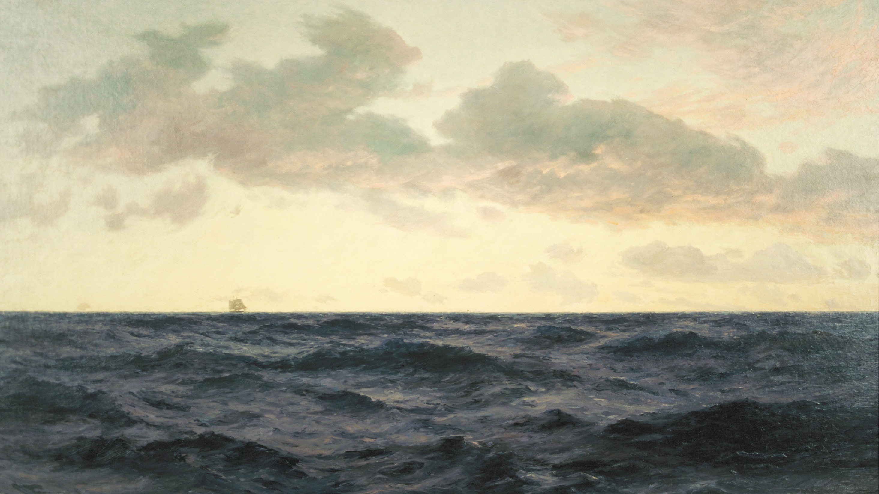
Distance
William Ayerst Ingram, Evening, 1898
Think: Write about the effect of Ingram including only the one almost invisible boat in this picture. What does your attention focus on? What seems important?
What does Ingram tell us about the sea? Can you describe it? What does this tell you about the distance that the ship has traveled?
Image: Guildhall Art Gallery, City of London

Slide 3
Distance
William Ayerst Ingram, Evening, 1898
Try: Look at the ways in which Ingram paints the light on the surfaces of clouds and sea. Can you copy it?
Look out for instances of light and shade playing on surfaces, picking out shapes. Make colour sketches of them. Look carefully at the range of colour as you work.
Image: Guildhall Art Gallery, City of London

Slide 4
Distance
William Ayerst Ingram, Evening, 1898
More: Research examples of contemporary artists making use of light in their work. You might like to start with James Turrell’s Deer Shelter at the Yorkshire Sculpture Park. You could think about how he plays with distance as well as uses light.
Image: Guildhall Art Gallery, City of London

